Slide 1

Indoor Navigation System
Shengxiong Wu - 217993254
Haochen Wang - 216754236
EECS4080/EECS4090

Slide 2
Introduction
Project overview:
Goal:
Develop an indoor navigation system
Motivation:
Save time
Contribute to the York University Community
Background Information:
Google Map can not navigate inside the building
Navigation system in the Mall required BIM(Building Information Model)
This software can navigate inside the building in the campus.
This software is web-based.

Slide 3
Software Development Life Cycle
Requirements Analysis
Design
Development
Testing
Deployment
Maintenance

Slide 4
Requirements Analysis
Functional Requirement:
Navigation Function
User Interface
Multi-floor support
Multi-building support
Non-Functional Requirement:
Response Time
Data Safety
Scalability
Technical Requirements:
Spring Boot
Web-development tech stack
Cloud deployment

Slide 5
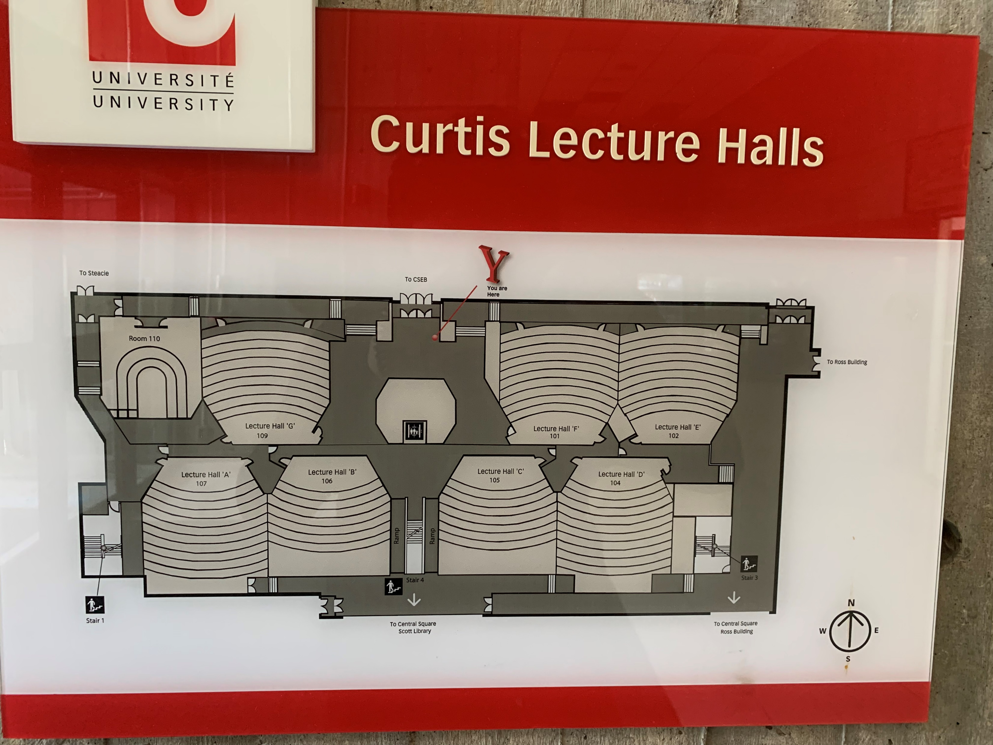
Design & Development
Floor Plan
Research
Map Library

Slide 6
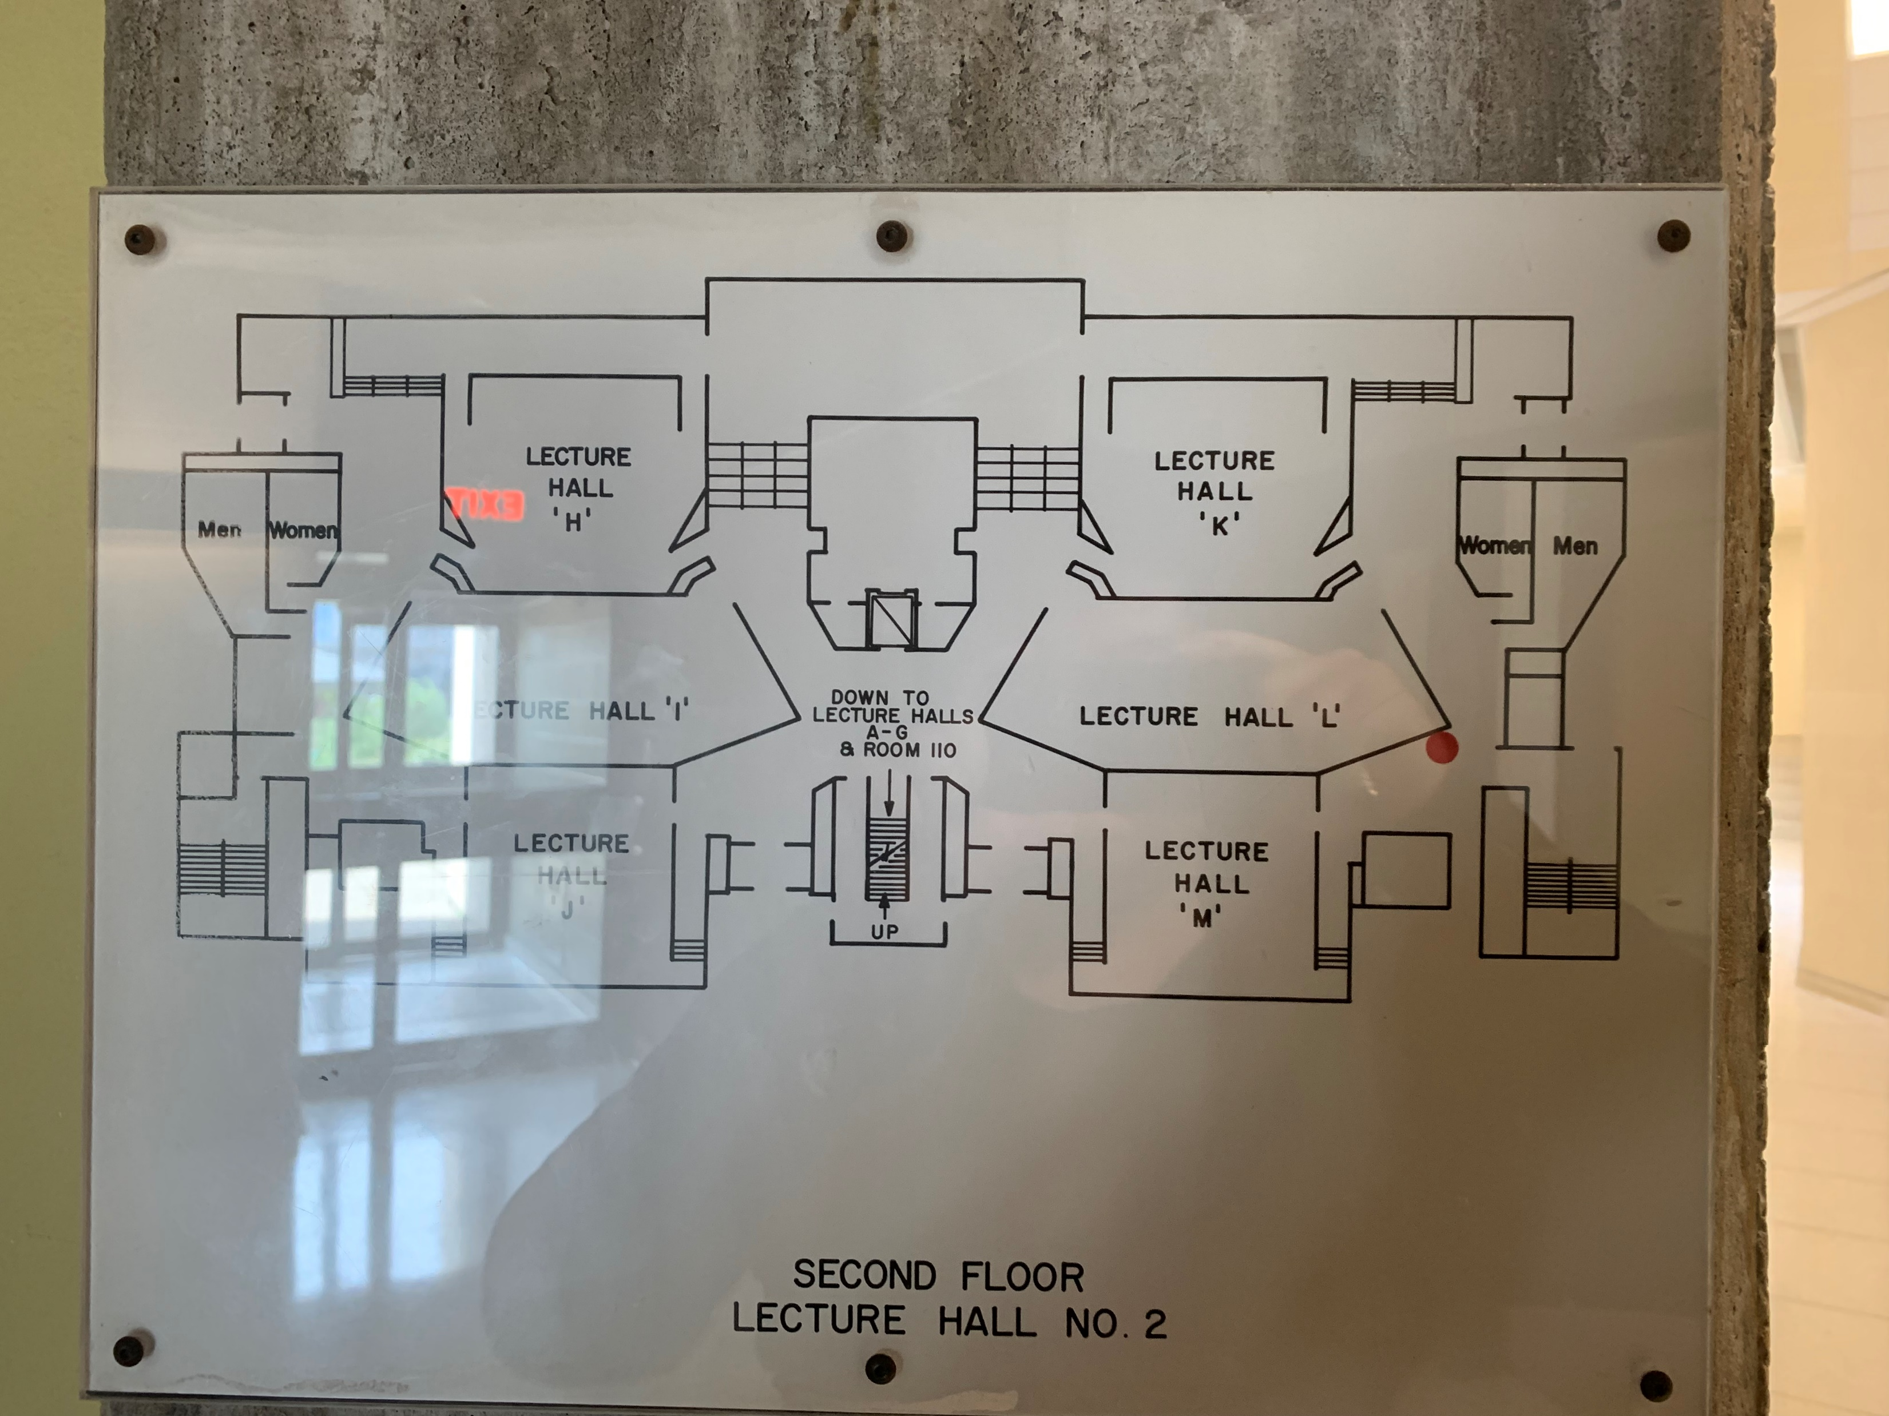
Floor Plan for CLH Level 2 by Photo

Slide 7
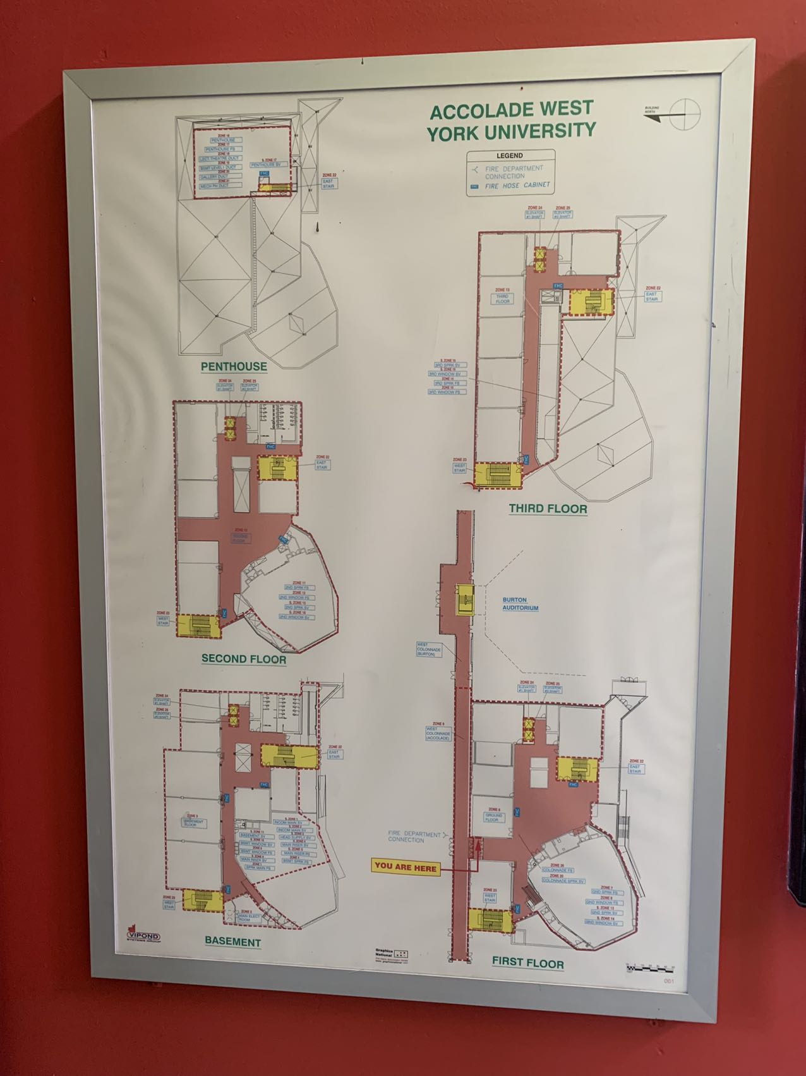
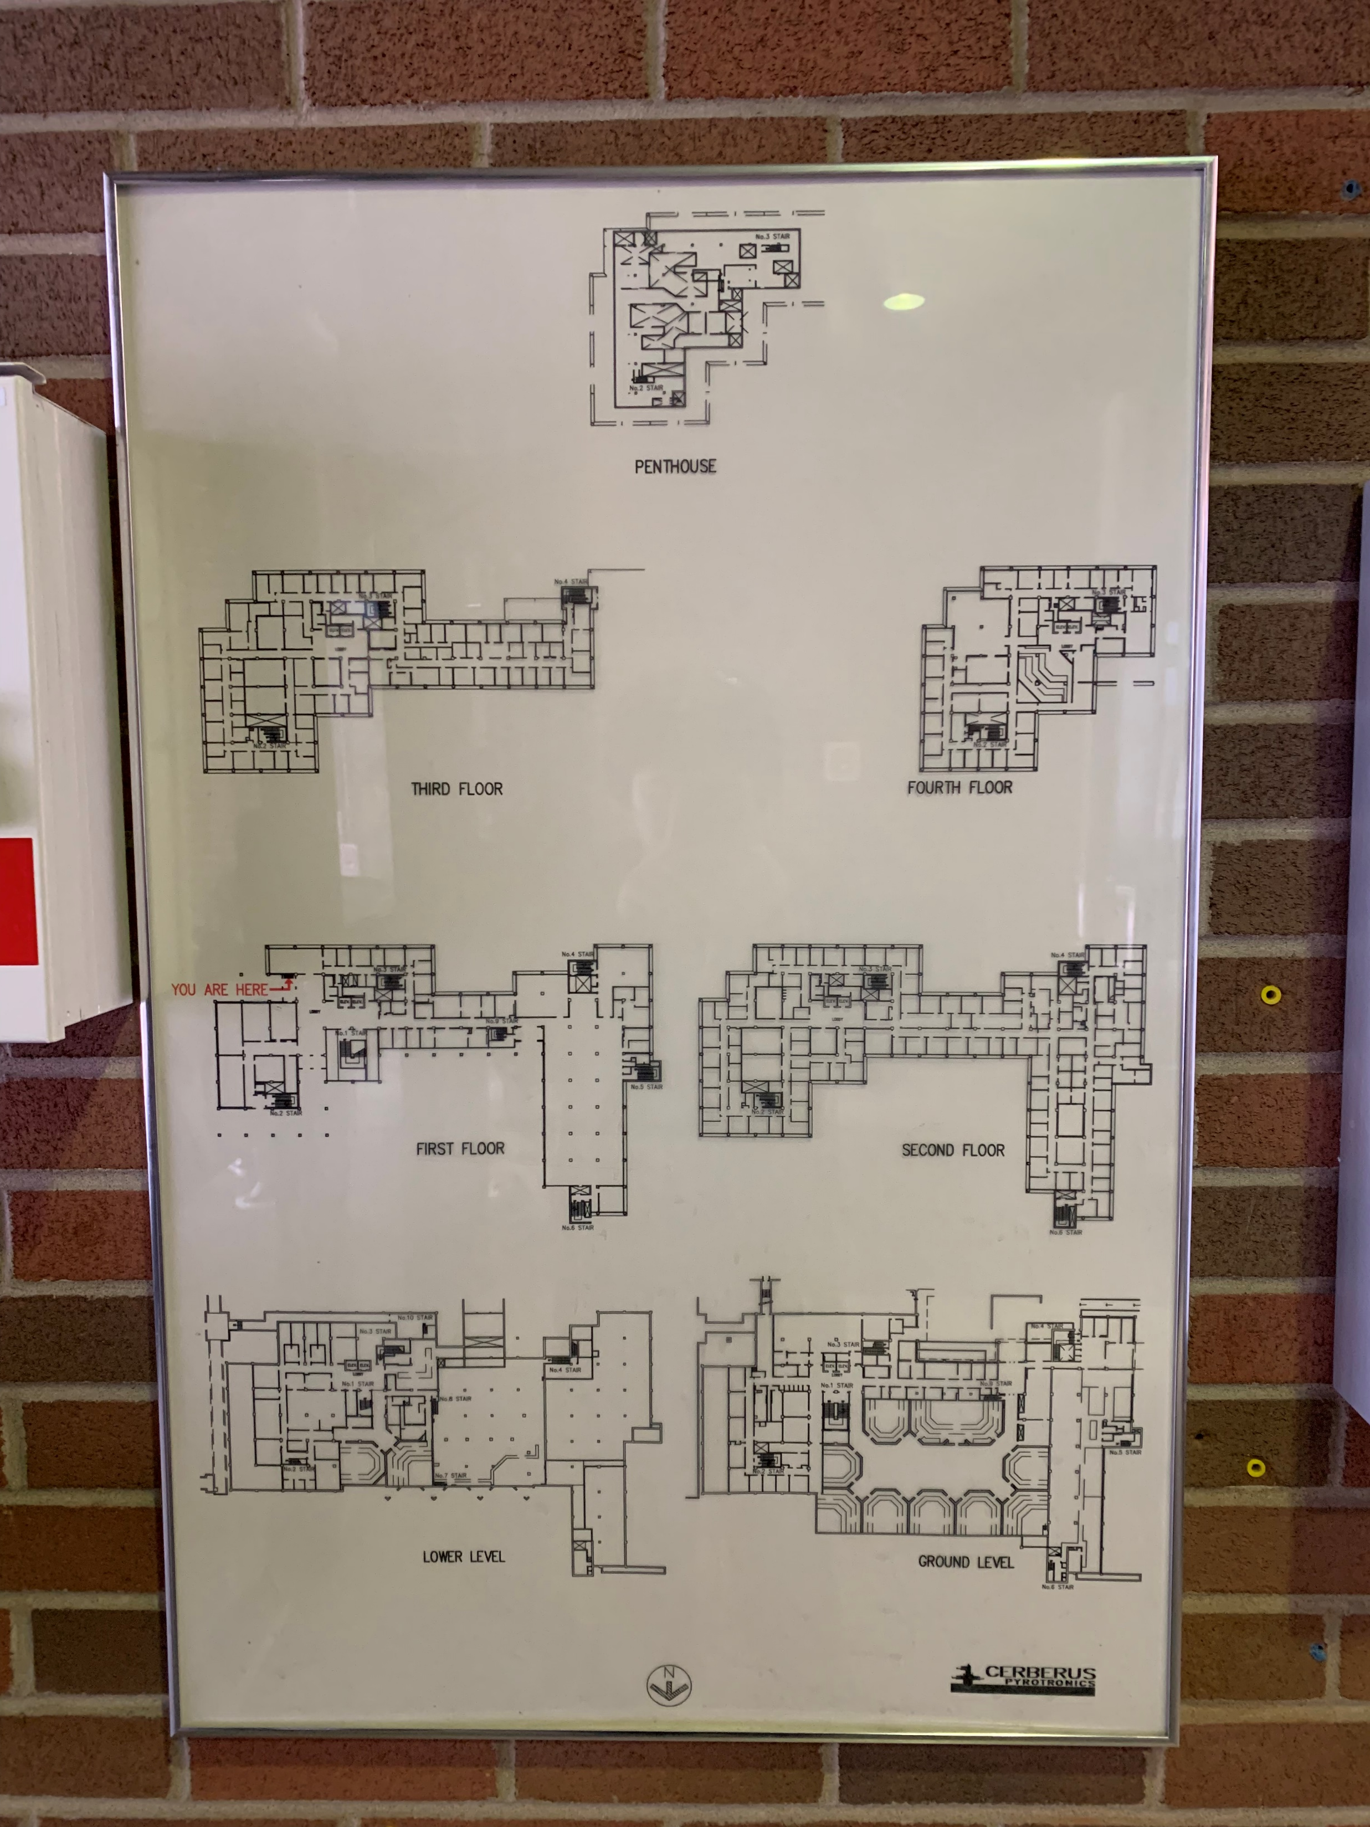
The format of floor plans varies across different buildings

Slide 8
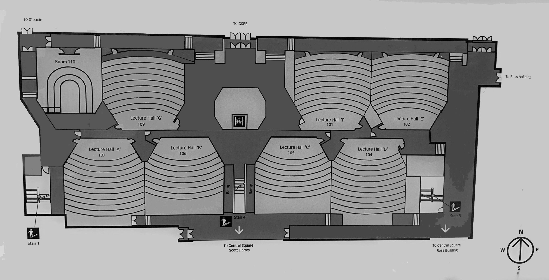
Proof of Concept

Slide 9
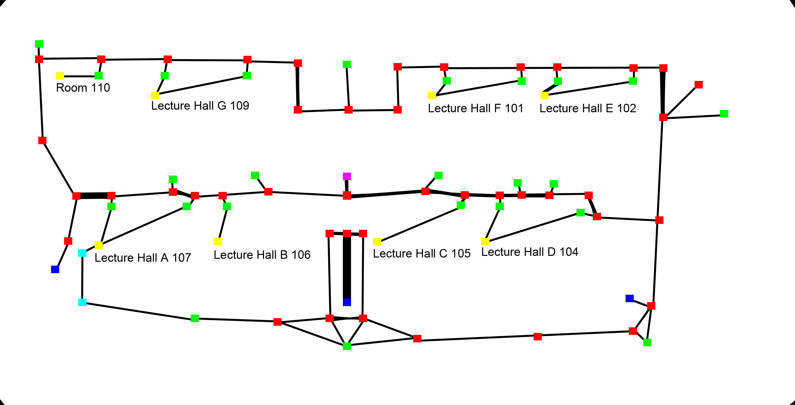
Extract Information from the Floor Plan

Slide 10
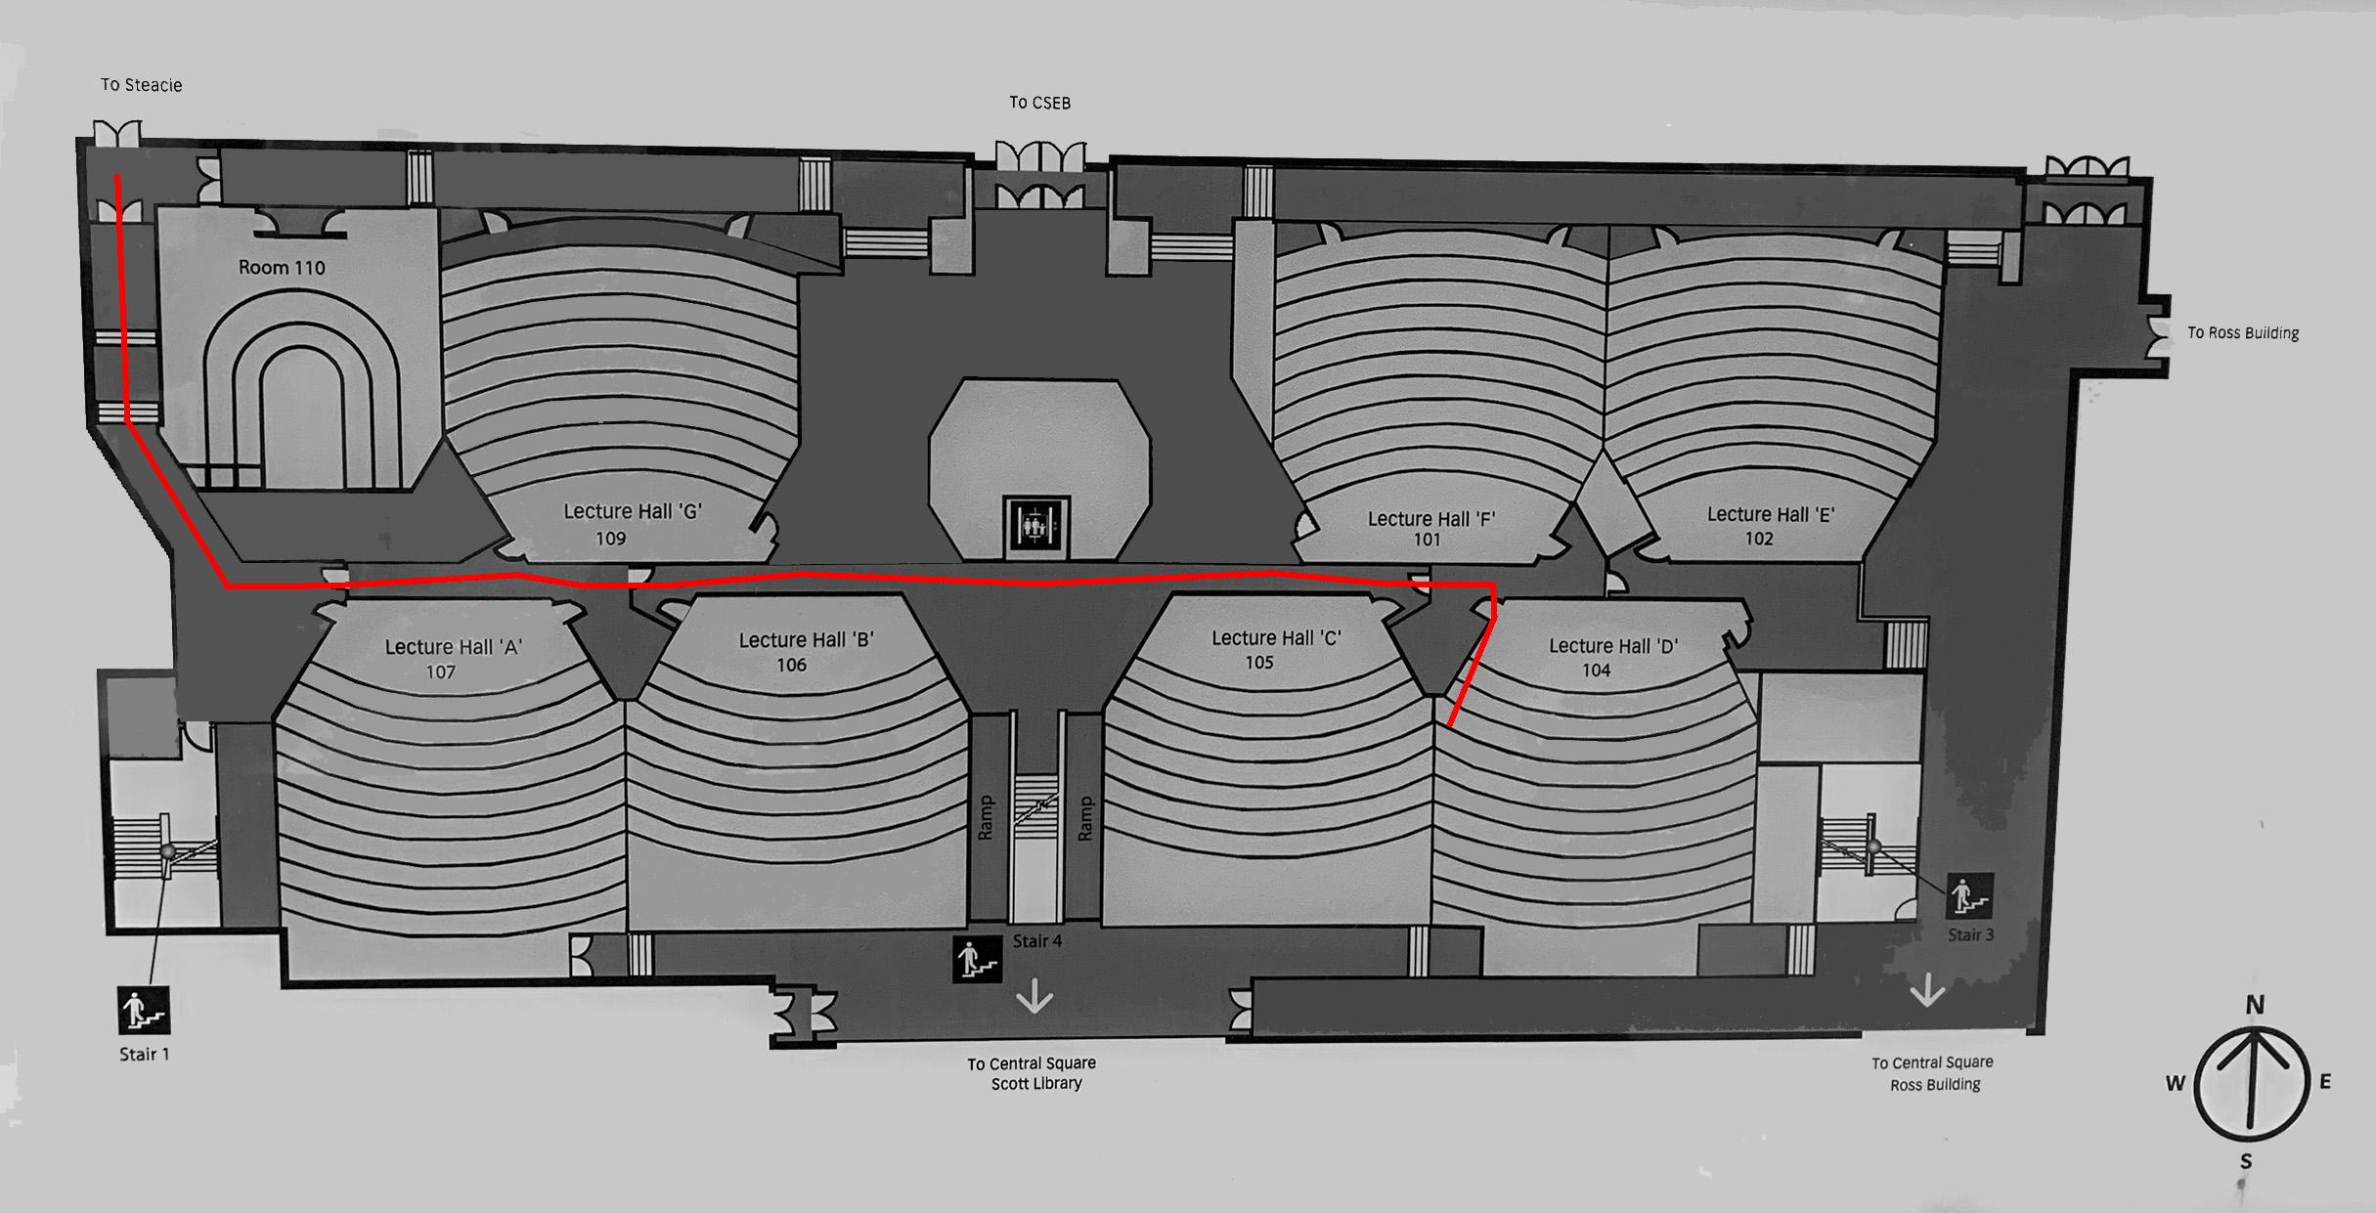
Applied Dijkstra’s Algorithm

Slide 11
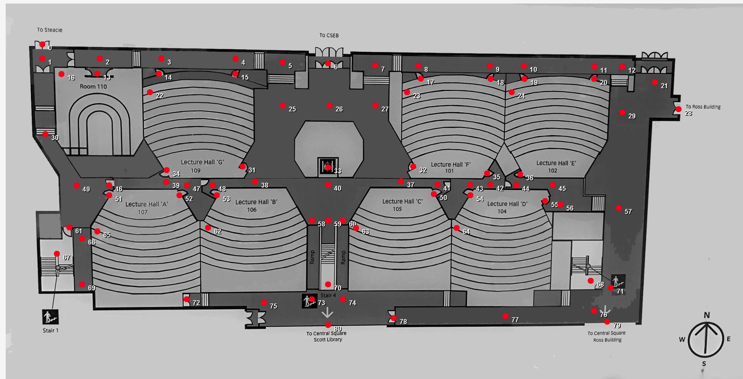
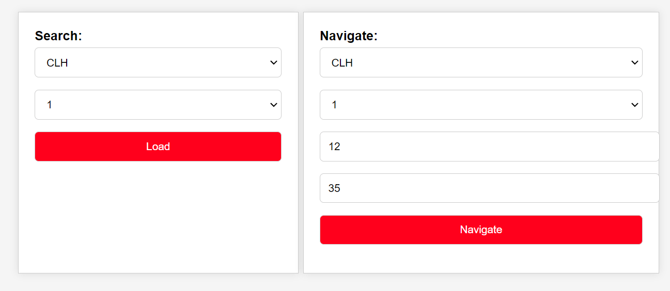
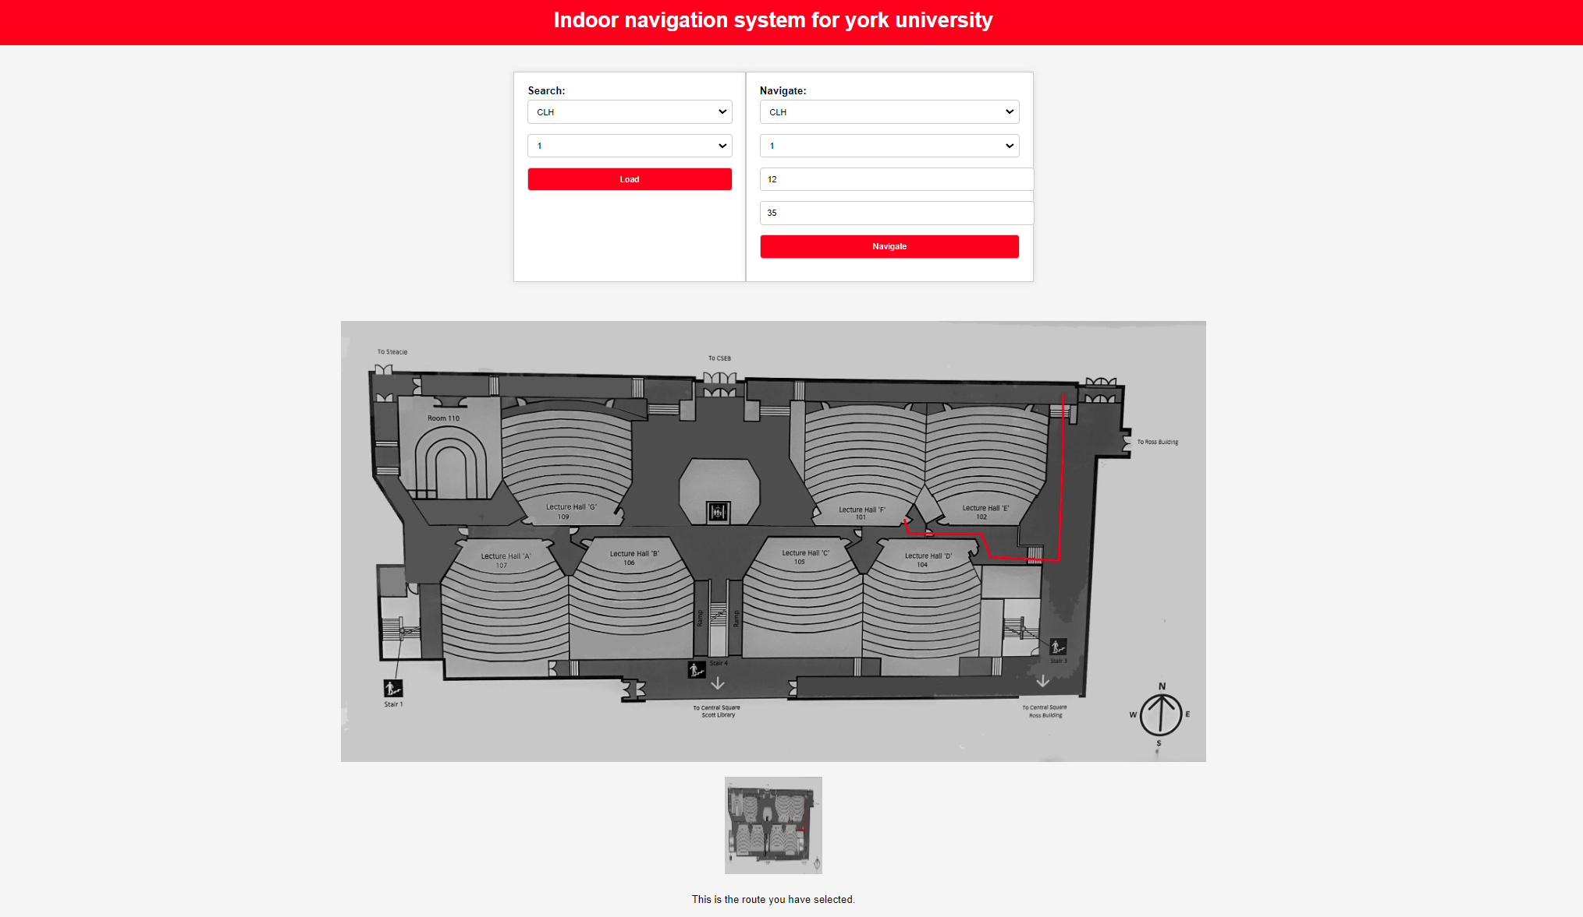
First Version

Slide 12
Problem
Need better floor plan
Need better way to extract information from floor plan
Need navigate by using room name rather than node index

Slide 13
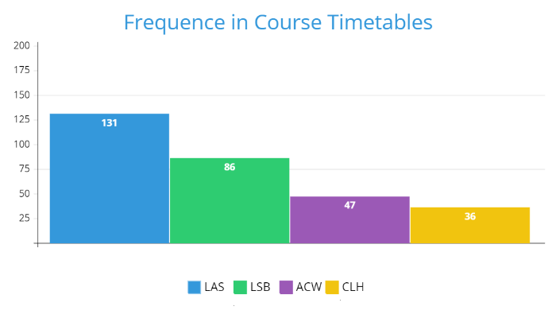
Help from Facilities Services/Campus Planning, Design & Construction
5 buildings:
LAS (Lassonde Building)
LSB (Life Sciences Building)
ACW (Accolade Building West)
CLH (Curtis Lecture Halls)
R (Ross Building)

Slide 14
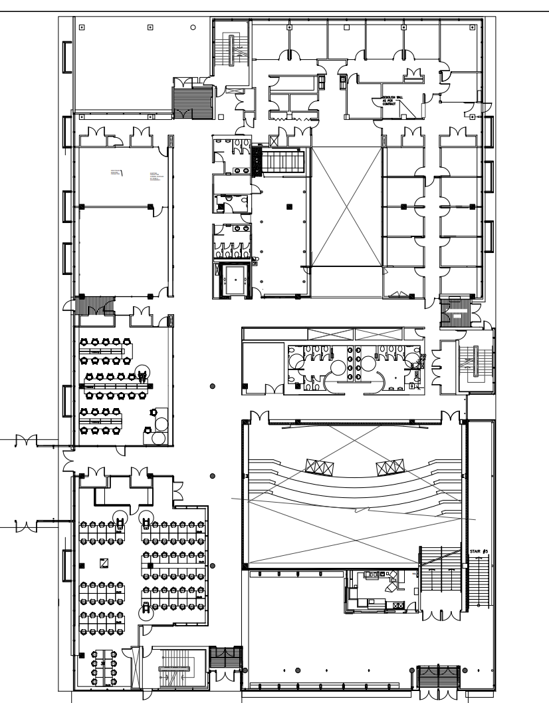
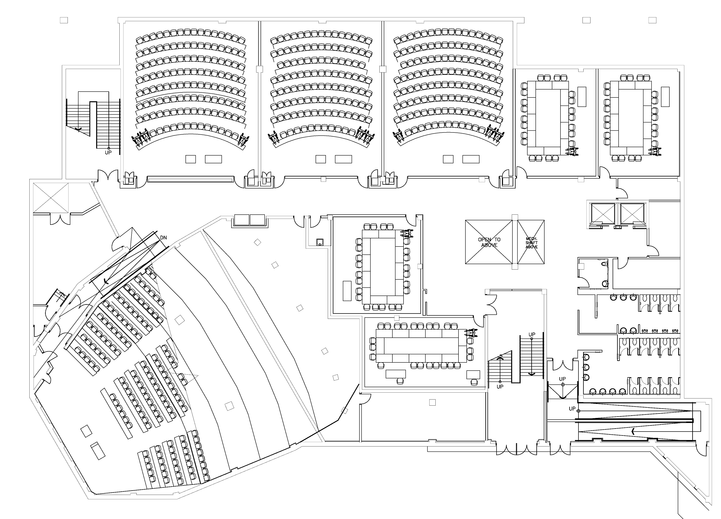
Digital Floor Plan

Slide 15
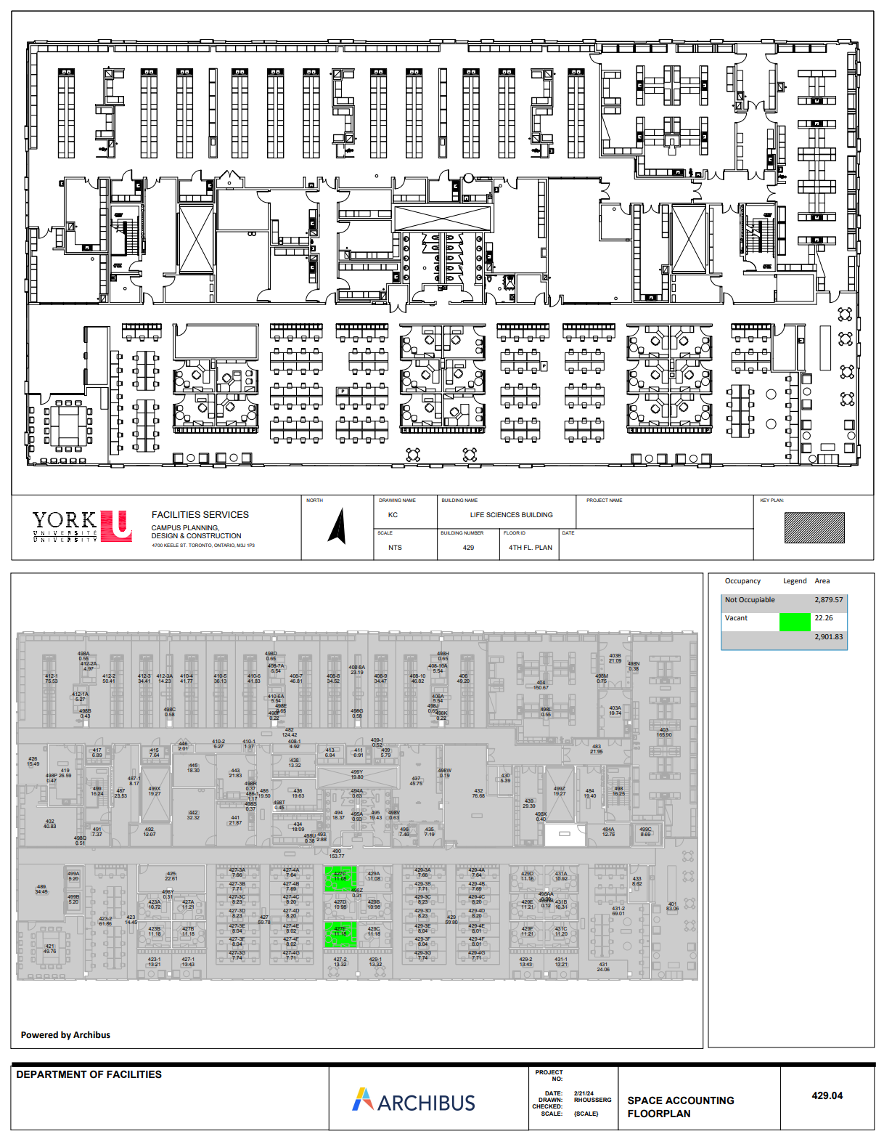

An Improved Notation Tool
Vector drawings delivered
Manual notating is still needed for now
Self-contained? Easy to use? Intuitive?

Slide 16

Notation Tool: Requirement Analysis
Needs to ready-to-use
Small footprint
Internet connection independent
Works locally with only the floorplan image, save to local then deploy to backend
Should be as intuitive as possible
Similar mode as the last generation solution
Point-and-click interaction
Performance shall be acceptable
As many as several hundred nodes on a single floor
Web-based solution with HTML + CSS + JS
HTML5 Canvas
Render anything controlled by JS
Not very easy to use!

Slide 17
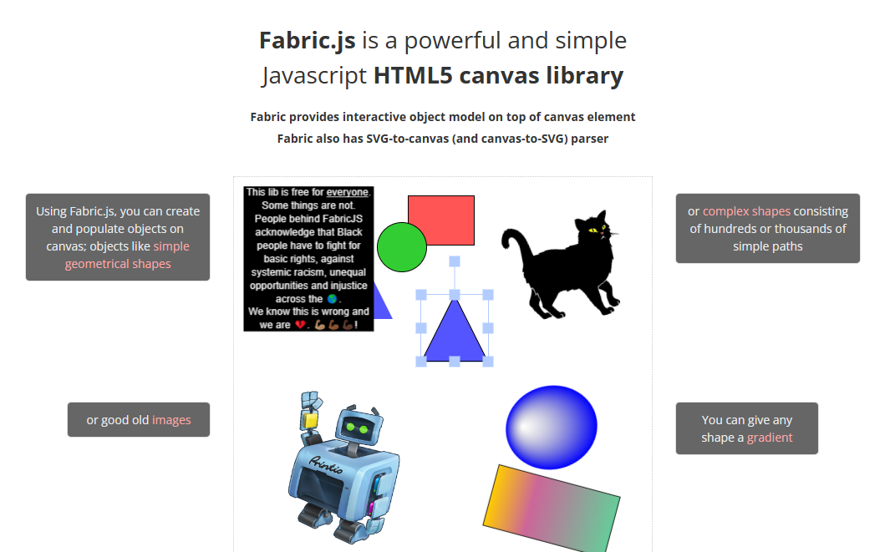
Enter Fabric.js

Slide 18
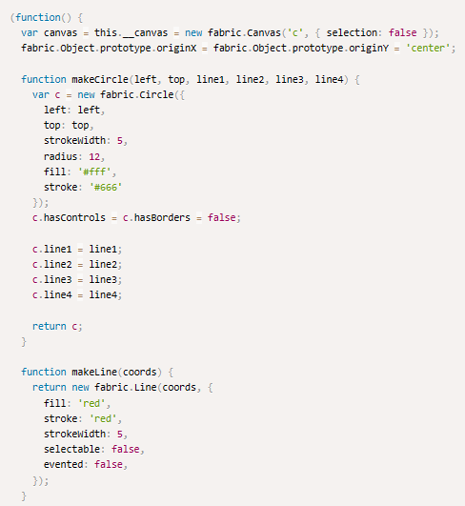
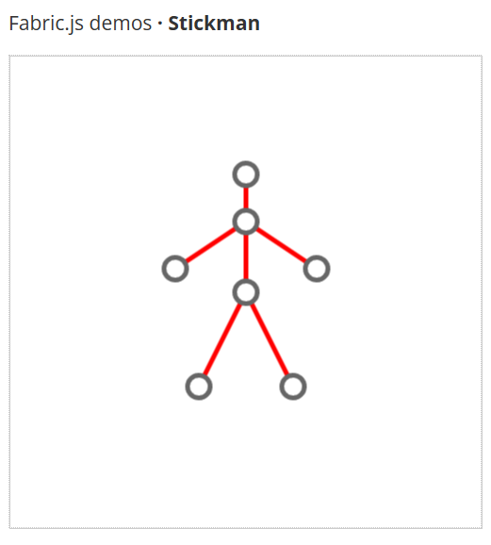
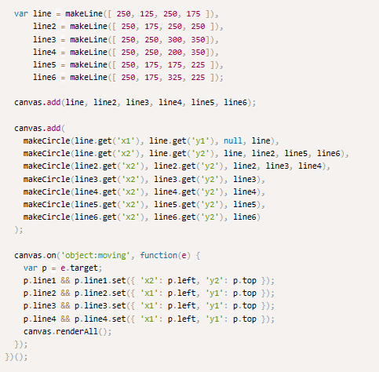
Looks similar…

Slide 19
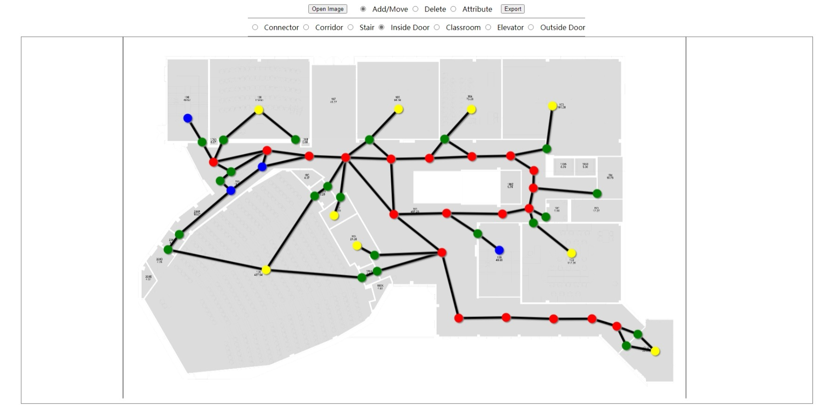
Notation Tool: Prototype

Slide 20
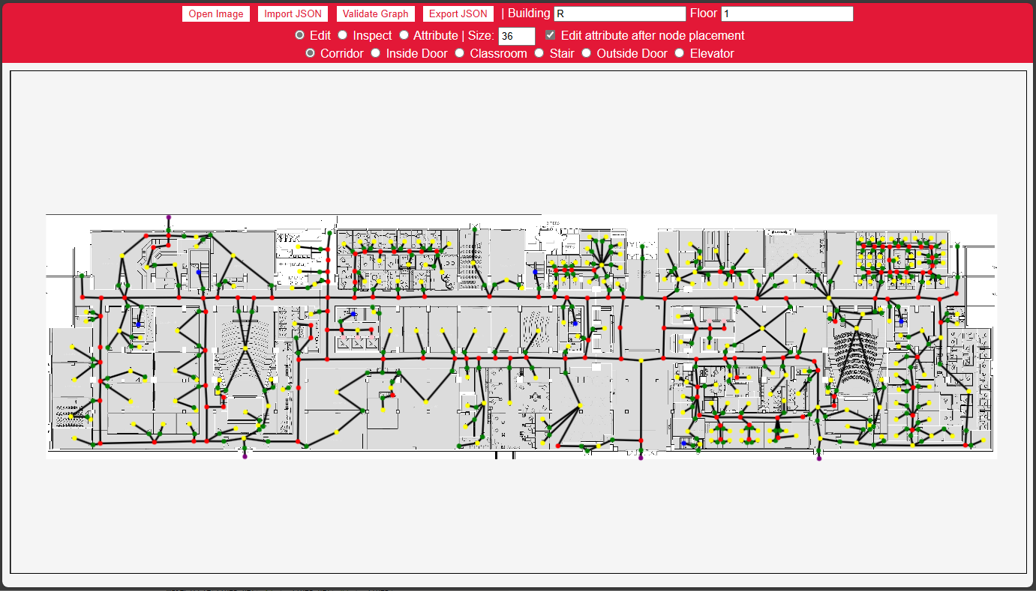
Notation Tool: Current State

Slide 21
Notation Tool: Efficiency
Tested with Ross Floor 1
Tested with CLH Floor 1
More than 40% faster

Slide 22

Result Caching
Generating the result images is SLOW!
~3 – 5 s for a single image
How to improve?
Breakthrough: with each route selected, the results are unique
Reuse is possible!
On-server cache needed
Unique key, Put, Contains, TTL
Unique key source
Route information -> [?] -> Unique key
Hashing
Start: CLH Floor 1 - Lecture Hall A
End: LAS Floor 1 - 1005-WC
navigate
CLH1_LectureHallA -> Campus_CLH
Campus_CLH -> Campus_LAS
Campus_LAS -> LAS1_1005-WC
getResultFileName

Slide 23

Result Caching
Popular cache database: Redis
Fast
Easy to deploy and use
Comes with all we need
Not optimized for binary storage
In memory!
Local filesystem
Unique Key: Filename
Put, Contains
TTL: Last Modified w/ cronjob
Another reason
Will talk about that in a second

Slide 24

Cloud Deployment
Deploy the web application to the Internet
Several things needed
Virtual Private Server (VPS)
Domain
TLS Certificate
VPS
Amazon Web Service Lightsail
Domain
Registered personal domain
gradproj.haoc.wang
DNS provider: Aliyun
Certificate
Let’s Encrypt
Free renewable cert for 3 months
ACME, certbot

Slide 25
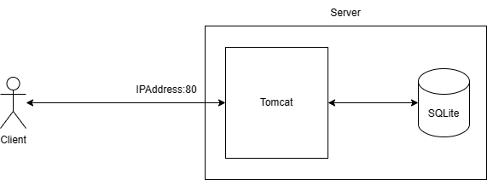
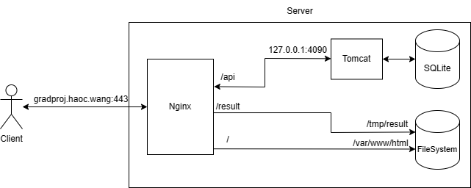
Cloud Deployment
Spring Boot’s built-in Tomcat is not very easy to configure
Compatibility with certbot
Performance
Reverse Proxy
Another web server in front of application web server
Nginx
Popular web server
Powerful proxy and rule configuration
Built-in support from certbot
Native-level local filesystem serving

Slide 26
Live Demonstration
https://gradproj.haoc.wang

Slide 27
Future Work
Improve the efficiency of the backend logics
Using Deep Learning or other CV techniques to automatically build the data from floor plan
Build the data in real time and location by using robot in the building

Slide 28

Thank You
Q&A and Defending Time
Shengxiong Wu – 217993254 – sxwu@my.yorku.ca
Haochen Wang – 216754236 – whc2001@my.yorku.ca

